Slide 1

Housing Price Predication & Analysis Project
By- Vinayak Patil
Internship Batch No- 34

Slide 2

Introduction to Housing Price Prediction
Now a day’s data science has a very important role to solve the problems to help the companies to increase the total revenue and profits. So it will be very useful to making a realistic machine learning model in the domain of real estate to predict the selling price of the property and the future scenario of the price that is how it is increased.

Slide 3
Problem Statement
A US-based housing company named Surprise Housing has decided to enter the Australian market. The company uses data analytics to purchase houses at a price below their actual values and flip them at a higher price. For the same purpose, the company has collected a data set from the sale of houses in Australia.
We are required to build a model using Machine Learning in order to predict the actual value of the prospective properties and decide whether to invest in them or not. For this company wants to know:
Which variables are important to predict the price of variable?
How do these variables describe the price of the house?

Slide 4
Conceptual Background of the Domain Problem
Predictive modelling, Market mix modelling, recommendation systems are some of the machine learning techniques used for achieving the business goals for housing companies. Our problem is related to one such housing company.
It is required to model the price of houses with the available independent variables. This model will then be used by the management to understand how exactly the prices vary with the variables. They can accordingly manipulate the strategy of the firm and concentrate on areas that will yield high returns. Further, the model will be a good way for the management to understand the pricing dynamics of a new market.

Slide 5
Mathematical Modelling of the Problem
The goal of this project is to predict the price of house with the help of regression-based algorithm. In this project different types of algorithms are used. The algorithms are used with their own mathematical equation on background.
This project have two separate data set for training & testing. First different steps of data pre-processing is performed over the training and testing data like data cleaning, data visualization, relationship between features with label. After this, unnecessary feature are removed. In model building Final model is select based on Accuracy score, RMSE value, Hyper parameter tuning and Cross Validation score of different algorithms. Then find the most important feature among all features.

Slide 6
Data Sources and their formats
Training data is used to train the model. It has 1168 rows and 81 columns. The model will train with the help of this dataset. It has 80 independent features and one dependent or target variable (SalePrice).
In other hand test data has 292 rows and 80 columns. After determine the proper model, the model is applied to predict the target variable for the test data.
To determine the data format, info() method is used. There are total 43 categorical columns among 81 columns.

Slide 7
Exploratory Data Analysis
Let’s start the observation exploration of feature analysis.

Slide 8
Project Flow Tasks Perform
Check the presence of duplicate or any data error.
Missing values present in data set.
Imputation of missing value with mean, median or mode is performed.
Feature Engineering for extraction of few new features out of existing features.
Feature selection
Label Encoding of Categorical features
Splitting of dataset into input & target feature
Standard Scaling of data
Finding Final model with respect to best R2 Score, RMSE

Slide 9
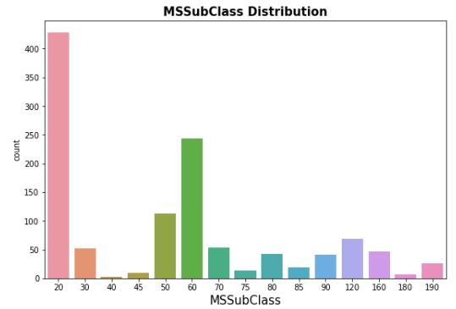
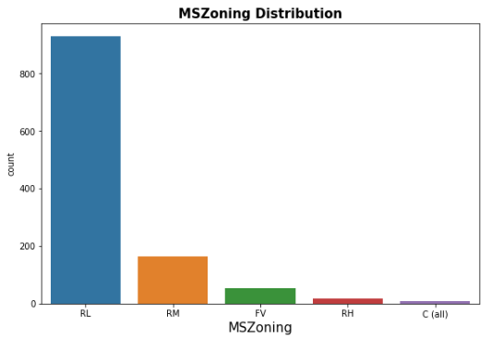
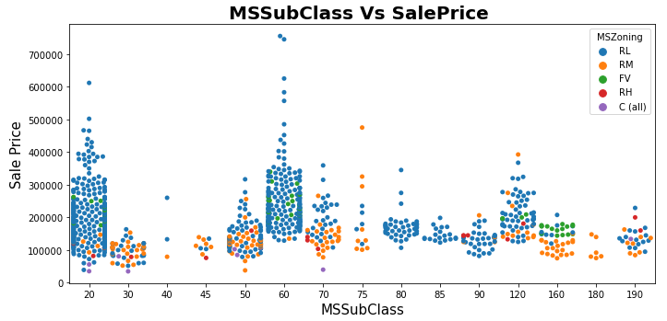

Slide 10
Observations:
For MSSubClass class 20 and 60, SalePrice is high and maximum MSZoning is Residential Low Density
79.5% of house are in Residential Low Density followed by 14 % of house are in Residential Medium Density area.
Floating Village Residential is only 4.5%
Very few house (0.8%) are in Commercial zone.

Slide 11
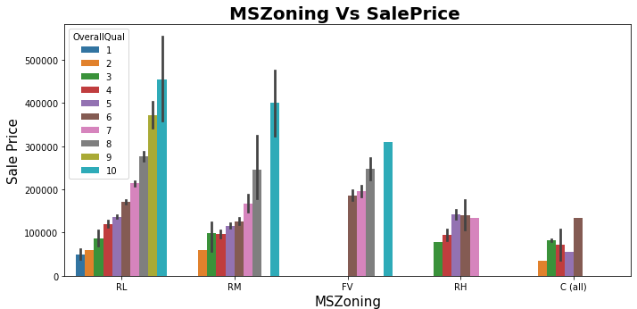
Observations:
1. Max property have overall condition rating of either 6 to 7.
2. Average selling price for RL zone property is 200000-500000.
3. In Commercial zone the property price is minimum.
4. Sale Price inside RL Zone is much higher than other zone.
5. It is clear that if OverallQual increased, SalePrice also increased.

Slide 12
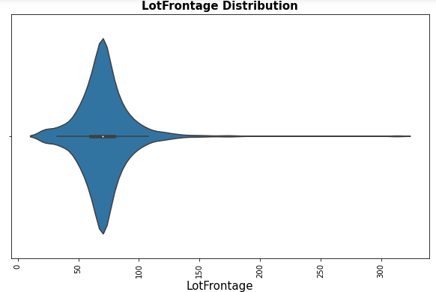
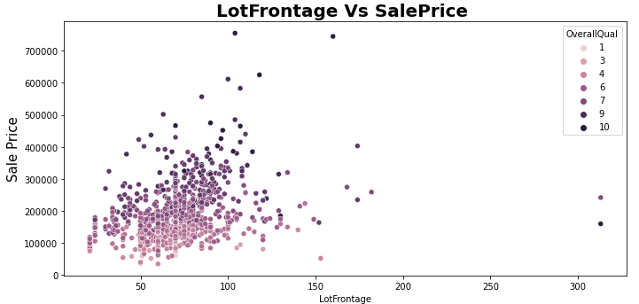
1. Average LotFrontage is around 50-80 2. A lot of outliers are present. 3. There is No Significant relationship found between SalePrice & LotFrontage.

Slide 13
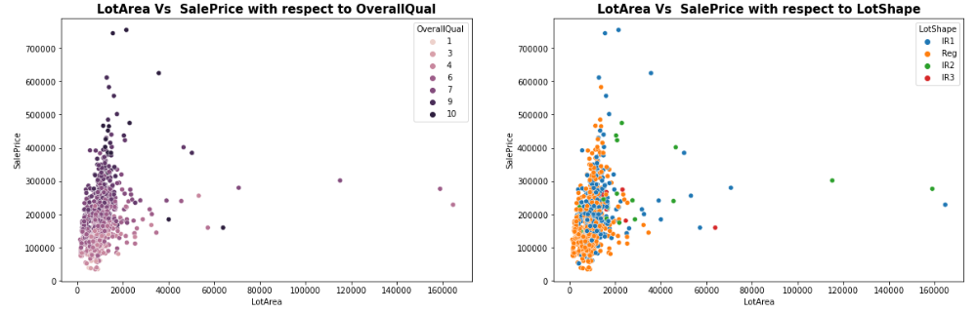
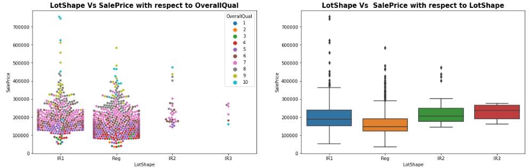
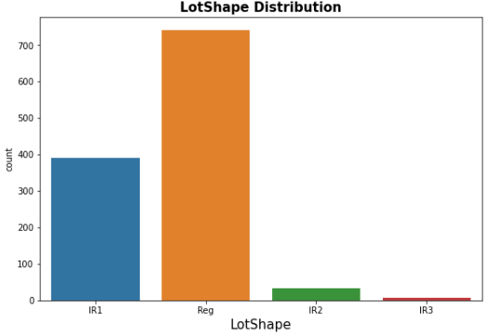

Slide 14
Observations:
Average LotArea is around 0-25000
A lot of outliers are present.
As OverallQual increased, saling price of the property also increased.
No relation is found between LotArea and SalePrice with respect to LotShape.
Min LotShape is Irregular.
63.4% LotShape is Regular followed by Slightly irregular and there is some outliers also with very high price range
There is no relationship between LotShape and selling price.

Slide 15
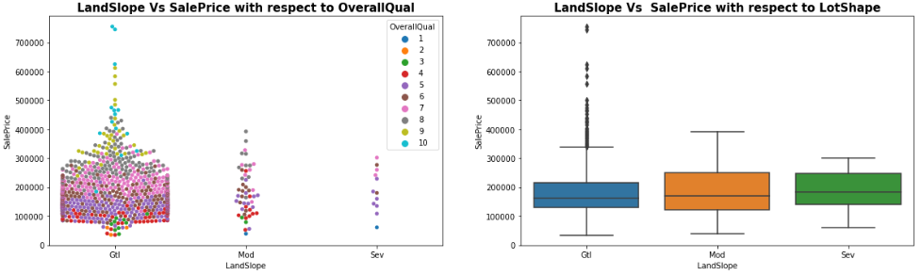
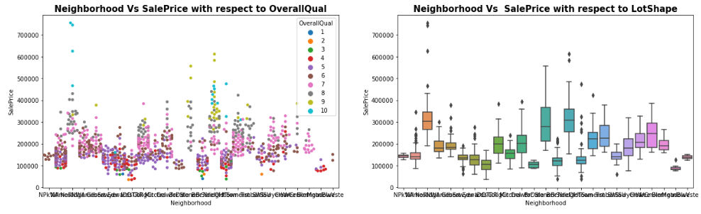

Slide 16
Observations:
72.1% of house comes with inside Lot configuration.
Cheapest property are in Inside lot configuration.
Only 2 are in Frontage on 3 sides of property.
95% LandSlope is Gentle slope.
1% properties come with severe slope and the average price is high compare to Gentle slope.
Max Neighborhood is Names with 182 values
Around 90% property is in Level land contour type. It is quite obvious also!!
Banked area is the less costly area compare to others.

Slide 17
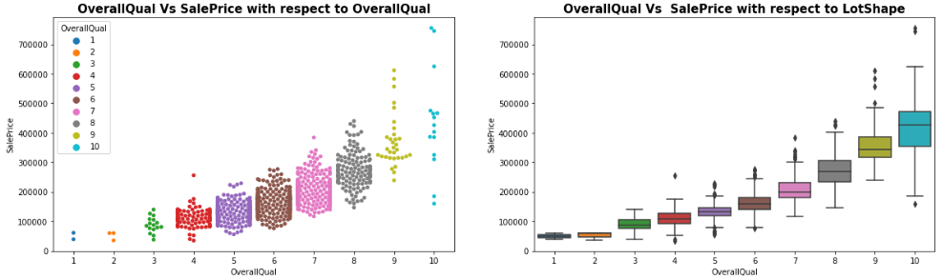
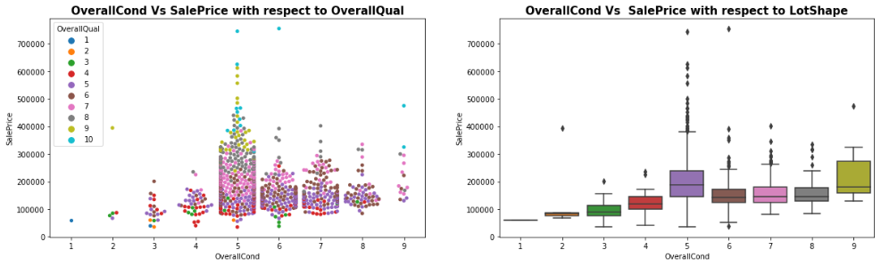

Slide 18
Observations:
Max OverallQual is with rating 5-7.
For OverallCond the max value is 5.
As usual if Overall Quality is increased, price is also increased.
Price is max for OverallCond 5

Slide 19
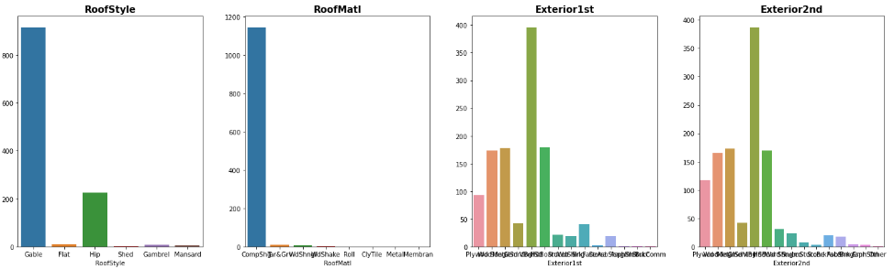
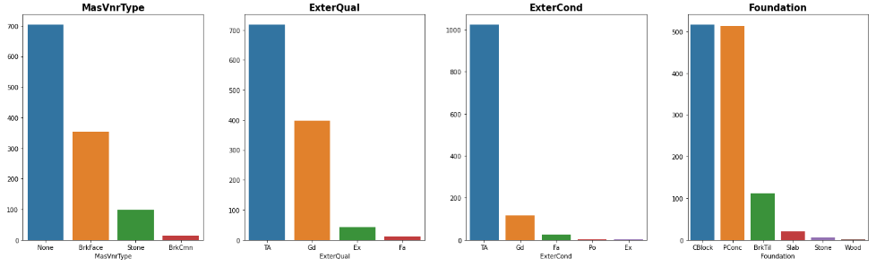

Slide 20
Observations:
1. 78.3% house is with Gable RoofStyle followed by 19.3 % house is with Hip Style.
2. 98% material is Standard (Composite) Shingle and other 7 types are only 2% togetherly.
3. Around 33% material is Vinyl Siding as Exterior covering on house for both Exterior1st and Exterior2nd.
4. Around 60% of house comes with None as Masonry veneer type. Maybe there is some mistake during entry the data.
5. Around 60% of house comes with Average quality of the material on the exterior.

Slide 21
Continue…
6. 87.5% of house comes with Average/Typical as the present condition of the material on the exterior.
7. Around 44% of house comes with both Cinder Block and Poured Contrite both Type of foundation.
8. Hip style Roof are much costly than rest of the roof style.
9. Wood Shingles is much costly than rest of the roof material.
10. Cement Board is much costly than rest of the Exterior covering on house.
11. The house made with stone as Masonry veneer is most costlier type.
12. Very obviously costlier house come with Excellent and Good exterior quality.
13. Pconc foundation are mostly use in costly housing properties.

Slide 22
Visualising different type of count plot and the relationship between these features ('BsmtQual', 'BsmtCond', 'BsmtExposure', 'BsmtFinType1', 'BsmtFinType2', 'Heating', 'HeatingQC', 'CentralAir') and Sale Price (target variable), we get the following observations.
1. Good and Typical are the maximum used basement height.
2. Max number of house is No Exposure with respect to Refers to walkout or garden level walls.
3. Most of the housing type are Good Living Quarters or Unfinshed.
4. For maximum case, the Type of heating is Gas forced warm air furnace
5. Max House is Central air conditioning.
6. It is very obvious that Execellent type is much costlier than other types of height of the basement, Heating quality and condition.
7. Central air conditioned housing proper is much costlier than non AC.
8. For maximum case, the Type of heating is Gas forced warm air furnace and it is the costlier type among rest of them.

Slide 23
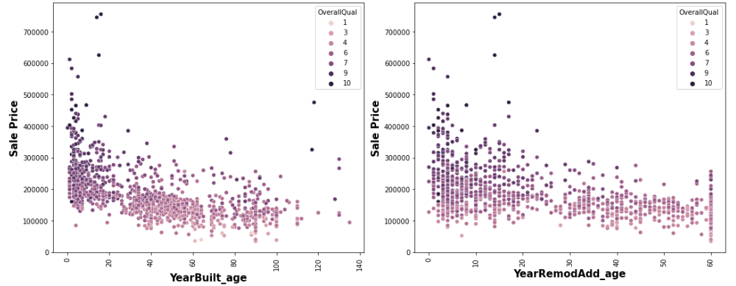
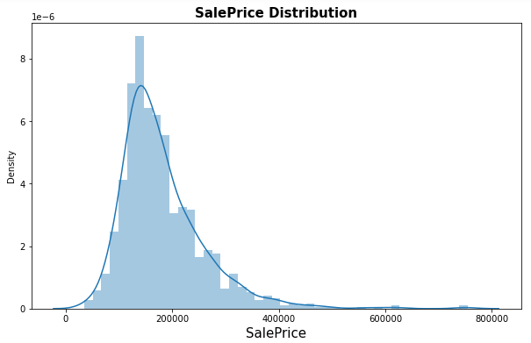
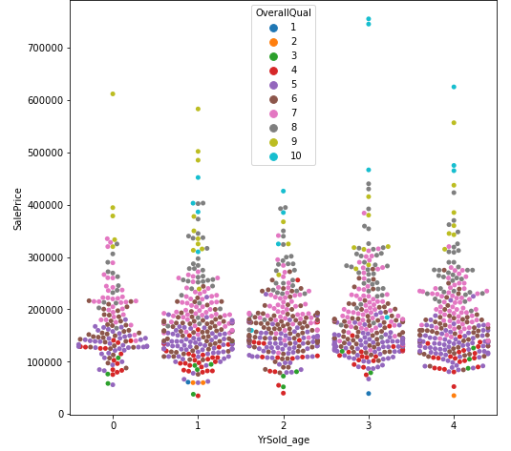
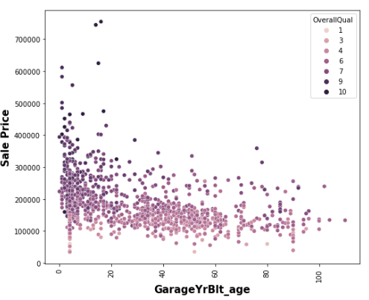

Slide 24
Observations:
1. The selling price of new property is higher than old one.
2. 10 years after Remodelling the properties, the price start decreasing.
3. The selling price of new garage is also higher than old one.
4. Average SalePrice is 100000 to 300000.
5. As OverallQual increased, SalePrice is also increased.

Slide 25
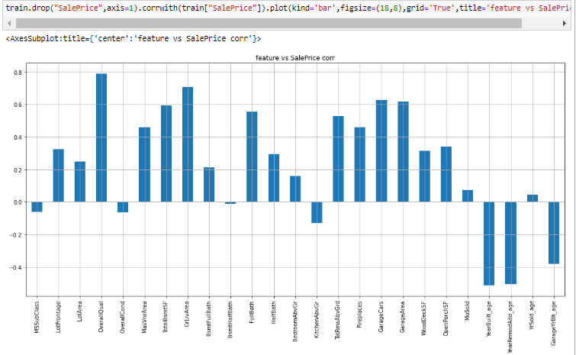
Correlation:
All the features are correlated with target. Overall quality and total ground area is highly correlated with target variable sales.

Slide 26
Machine Learning Model Building

Slide 27
Machine Learning Algorithm Used
The different regression algorithm used in this project to build ML model are as below:
Linear Regression.
DecisionTreeRegressor
KNeighborsRegressor
RandomForestRegressor
SupportVectorRegressor
GradientBoostingRegressor
AdaBoostRegressor

Slide 28
ML Model Building Flow
Standard Scaling of Data
Splitting Training Data Using test_train_split
Finding Best Random state
Training ML Model on Different Algorithms
Hyper Parameter Tuning of every model
Apply 5 Fold Cross Validation with every different Model
Selection of Best Model Based on Evaluation Criteria
Saving final Model
Find best contributed feature among all of the features.
Predicating Test Dataset using Final Model

Slide 29
Key Findings and Conclusions of the Study
Tables of Findings using different algorithms after Hyper Parameter Tuning
Algorithm | R2 Score | RMSE Value | CV Score | Standard Deviation
Linear Regression | 0.882 | 25567 | 0.789 | 0.052
Decision Tree Regressor | 0.788 | 34209 | 0.738 | 0.052
KNeighbors Regressor | 0.862 | 27563 | 0.790 | 0.030
Random Forest Regressor | 0.904 | 22967 | 0.829 | 0.035
SVR | 0.632 | 45080 | 0.595 | 0.038
Gradient Boosting Regressor | 0.924 | 20445 | 0.853 | 0.035
Ada Boost Regressor | 0.824 | 31123 | 0.766 | 0.049

Slide 30
Conclusion:
Here Gradient Boosting Regressor giving maximum R2 Score, minimum RMSE Value, Maximum CV Score and minimum Standard Deviation. So Gradient Boosting Regressor is selected as best model. The final R2 Score is 0.924 that is 92.4%.

Slide 31
Limitations of this work and Scope for Future Work
Some additional features can be added to the dataset. For this addition we can able to perform some more advance model of ML.
Artificial Neural Network can be used create more accurate model.
The model will be more accurate if the dataset (set of observations) is bigger.
The model will be more accurate if there is no missing data.

Slide 32


